Slide 1
Final EES Rating
4/30/2014
Notes:
Welcome to this Hawaii Growth Model Presentation: Interpreting Hawaii Growth Model Ratings.
We can’t answer
Why a certain percent
Why are

Slide 2
Purpose
Identify EES Rating Components
Explain how components affect overall rating
Explain where teachers can be their data
Notes:
The purpose of this presentation is to explain how to read the Hawaii Growth Model rating information that will be provided on March 31st
and to give additional information to help you better understand components of this rating.
SO we are here to answer how questions, not the why
Teacher leader workgroups using the TLW PARKING LOT

Slide 3
Final EES Rating Into PDE³
Teacher Practice
Student Learning and Growth
Student Learning Objective
Classroom Observations/Working Portfolio
Hawaii Growth Model
Core Professionalism
Tripod

Slide 4
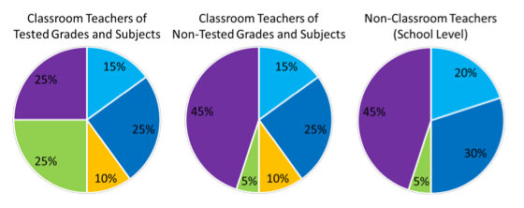
Final EES Rating Depends on Category
http://eesteacher.weebly.com/ees-manual.html
Notes:
If you look EES Manual page 25, PIES are broken down into specific components. The WEIGHT of each component depends on your teaching category.
I am going to be talking about the different pies.

Slide 5
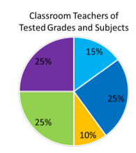
Teacher of Tested Grades and Subjects
(4-8th grade English and/or Math Teacher)
Student Growth and Learning
Teacher Practice
25% Student Learning Objective
15% Core Professionalism
25% Classroom Observations
25% Hawaii Growth Model
10% Tripod
Notes:
Tying everything together: If you are a classroom teacher of tested grades and subjects (This means you teach a 4-8 grade English and/or Math) Student Learning Objectives are worth 25%. Hawaii Growth Model (or your INDIVIDUAL MSGP) is worth 25% as well. SLOs and SGPs represent your Student’s Growth and Learning. For teacher practice, Core Professionalism is worth 15%, Classroom observations (or Danielson's) are worth 25% and Tripod survey results are worth 10%.

Slide 6
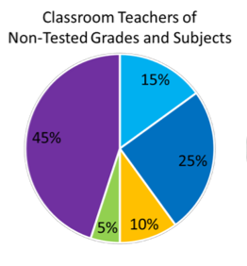
Classroom Teacher of Non-Tested Grades and Subjects
(NOT 4-8th grade English and/or Math Teacher)
Student Growth and Learning
Teacher Practice
15% Core Professionalism
45% Student Learning Objective
25% Classroom Observations
5% Hawaii
Growth Model
10% Tripod
Notes:
Likewise, if you are a classroom teacher of tested non-tested grades and subjects (This means you teach K-3 grade students, 9-12 grade students or a 4-8 grade classroom teacher who DOES NOT teach English or Math) Student Learning Objectives are worth 45%. Hawaii Growth Model (or your SCHOOL MSGP) is worth 5%. SLOs and SGPs represent your Student’s Growth and Learning. For teacher practice, Core Professionalism is worth 15%, Classroom observations (or Danielson's) are worth 25% and Tripod survey results are worth 10%.

Slide 7
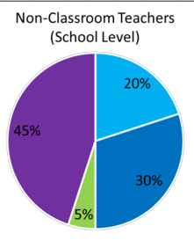
Non-Classroom Teacher
Student Growth and Learning
Teacher Practice
20% Core Professionalism
45% Student Learning Objective
5% Hawaii Growth Model
30% Classroom Observations
Notes:
Likewise, if you are a non-classroom, Student Learning Objectives are worth 45%. Please keep in mind you AVERAGE BOTH SLOS. Hawaii Growth Model (or your SCHOOL MSGP) is worth 5%. SLOs and SGPs represent your Student’s Growth and Learning. For teacher practice, Core Professionalism is worth 20% and Working Portfolio is worth 230%

Slide 8
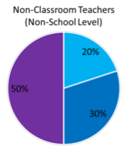
New Classroom Teacher
Student Growth and Learning
Teacher Practice
?
20% Core Professionalism
50% Student Learning Objective
30% Classroom Observation
Notes:
New Teachers: Student Learning Objectives are worth 50%. Please keep in mind BOTH YOUR SLOs are averaged. SLOs represent your Student’s Growth and Learning. For teacher practice, Core Professionalism is worth 20% and your Classroom observations (or Danielson's) are worth 30%.
If you are a teacher with MISSING DATA or special circomstances, please write it on a post it and put it on my parking lot…

Slide 9
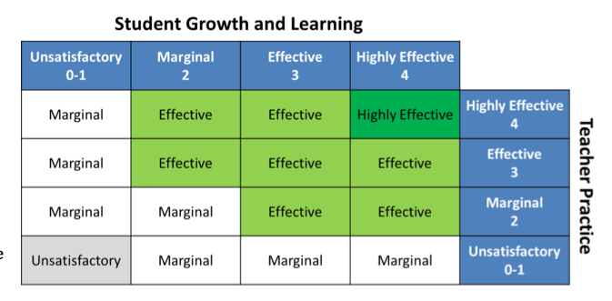
Final EES Rating Matrix
Notes:
Each teacher’s overall effectiveness rating can then be determined by matching the teacher’s rating on student growth and learning with the teacher’s rating on teacher practice using the matrix shown.

Slide 10
Tested Grade and Subject (E1)
Student Growth and Learning
Teacher Practice
2
3
25% Student Learning Objective
15% Core Professionalism
3
3
3
1
25% Classroom Observations
3
25% Hawaii Growth Model
10% Tripod
Notes:
How does this pie work?
For each component, you will get an individual rating or raw score.

Slide 11
Final EES Rating Based on EES Matrix

Slide 12
Non-Tested Grades and Subjects (E2)
(NOT 4-8th grade English and/or Math Teacher)
Student Growth and Learning
Teacher Practice
2.8
3
3
3
3
1
3
Notes:
Likewise, if you are a classroom teacher of tested non-tested grades and subjects (This means you teach K-3 grade students, 9-12 grade students or a 4-8 grade classroom teacher who DOES NOT teach English or Math) Student Learning Objectives are worth 45%. Hawaii Growth Model (or your SCHOOL MSGP) is worth 5%. SLOs and SGPs represent your Student’s Growth and Learning. For teacher practice, Core Professionalism is worth 15%, Classroom observations (or Danielson's) are worth 25% and Tripod survey results are worth 10%.

Slide 13
Final EES Rating Based on EES Matrix

Slide 14
Tested Grade and Subject (E3)
Student Growth and Learning
Teacher Practice
2
3
3
1
3
3
3
Notes:
How does this pie work?
For each component, you will get an individual rating or raw score.

Slide 15
Final EES Rating Based EES Matrix

Slide 16
Non-Tested Grades and Subjects (E4)
(NOT 4-8th grade English and/or Math Teacher)
Student Growth and Learning
Teacher Practice
1.2
3
3
1
3
3
3
Notes:
Likewise, if you are a classroom teacher of tested non-tested grades and subjects (This means you teach K-3 grade students, 9-12 grade students or a 4-8 grade classroom teacher who DOES NOT teach English or Math) Student Learning Objectives are worth 45%. Hawaii Growth Model (or your SCHOOL MSGP) is worth 5%. SLOs and SGPs represent your Student’s Growth and Learning. For teacher practice, Core Professionalism is worth 15%, Classroom observations (or Danielson's) are worth 25% and Tripod survey results are worth 10%.

Slide 17
Final EES Based on EES Matrix

Slide 18
www.pde3.k12.hi.us
Sign In
Go to Educator Effectiveness Tab
Go to Summary Tab
Notes:
To find Information

Slide 19
Overall Effectiveness in PDE3

Slide 20
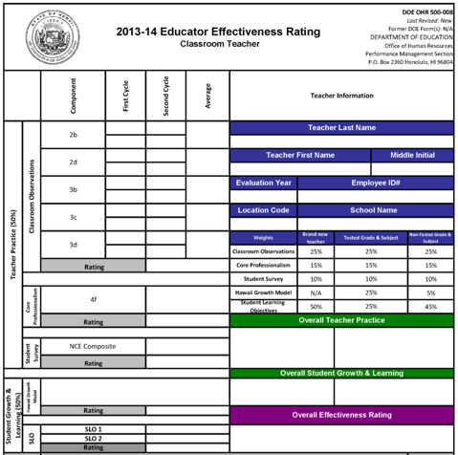
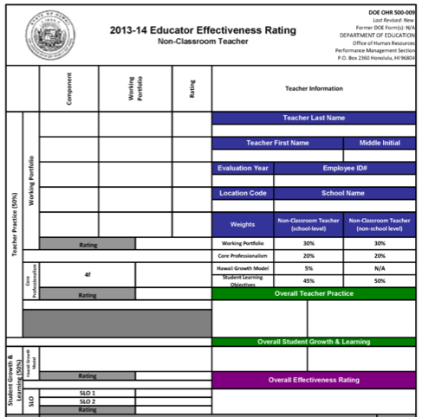
Final EES Rating Simulator
Classroom
Non Classroom

Slide 21
Classroom Teacher
New Teachers Use this Simulator too
Tested or Non-Tested
http://eesteacher.weebly.com/
Notes:
Teachers of Tested Grades and Subjects OR Non-Tested Grade and Subject

Slide 22
Non-Classroom Teacher
Non Classroom Teacher

Slide 23
www.eesteacher.weebly.com
EES Manual Tab

Slide 24
All Information Provided
www.eesteacher.weebly.com
Items from this presentation can be found on
http://castlekahukucast.weebly.com/
Notes:
For More Information on Student Growth Percentile, Data Distribution and SGP FAQs and behind the scenes functions of components discussed in this presentaion, please visit the Castle-Kahuku EES Website:

