Slide 1
Hawaii Growth Model
Interpreting Hawaii Growth Model
Ratings
Notes:
Welcome to this Hawaii Growth Model Presentation: Interpreting Hawaii Growth Model Ratings.
We can’t answer
Why a certain percent
Why are

Slide 2
SGP Data Loaded Into PDE³
Tested Grades and Subjects
Median growth percentile (MGP) for approximately 2500 teachers
Percentile rank assigned to each teacher
Rating (1-4)
Non Tested Grades and Subjects (school level)
School English Language Arts MGP taken from Strive Hi
Percentile rank assigned to each teacher
Rating (1-4)
March 31

Slide 3
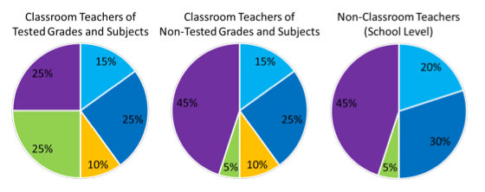
What is the Hawaii Growth Model?
Summative EES Ratings
http://eesteacher.weebly.com/ees-manual.html
Notes:
What this means is: the Hawaii Growth Model rating are part of a school level teacher’s Summative EES Rating.
This means that this model rating is worth 25% of an overall EES Rating for English and/or Math teachers of 4-8 grade students.
Or it is worth 5% an overall EES rating for K-3rd grade teachers, 9-12 grade teachers, teachers who teach subjects other than English or Math and non-classroom teachers, like counselors, school librarians and SSCs.

Slide 4
Hawaii Growth Model for Teacher of Tested Grades and Subjects
Individual MSGP | Individual Percentile rank | EES Rating
78 | 85 | 4
Notes:
If you are a teacher of tested grades and subjects:
The information you will on March 31st includes:
An Individual median student growth percentile score
An Individual Percentile Rank
An Educator Effectiveness System Rating

Slide 5
Scored 307 in 3rd grade
Scored 449 in 3rd grade
4th Grade Students
335
353
376
303
415
445
436
451
371
480
4th Grade Scores
Scored 150 in 3rd grade
270
298
284
197
315

Slide 6
Scored 307 in 3rd grade
Scored 449 in 3rd grade
303
335
353
376
415
371
436
445
451
480
11
31
50
58
86
19
24
52
64
99
Student Growth Percentiles
Scored 150 in 3rd grade
197
270
284
298
315
35
39
61
82
95

Slide 7
What does SGP mean?
82th
In 4th Grade, Kai scored higher than 83% of his academic peers.
1
Low
Growth
35
Typical
Growth
65
High
Growth
99
Notes:
An SGP means that a student scored higher than a certain percent of his or her academic peer group.
For example, an SGP of 83 means Kai’s HSA score for reading was higher than 83% of his academic peers.
http://www.sophia.org/tutorials/percentile-rank--6?from_many_ways=true

Slide 8
Teacher of Tested Grades and Subjects Individual MSGP
Median Growth Percentile
(MGP)
78
Student Growth Percentile
(SGP)
78
15
51
76
80
82
88
Notes:
Applied to your Individual Median Student Growth Percentile, the SGPs of students whom you taught English or Math to are put into numerical order.
The MIDDLE score determines your median student growth percentile. By the way, did you notice how Kai received an SGP of 83 from having spent a year in your class last year?
http://eesteacher.weebly.com/1/post/2013/05/how-will-data-from-very-small-schools-and-groups-be-reported-is-there-an-established-minimum-group-size-for-creating-a-median-growth-percentile-msgp-for-a-school-disaggregated-group-classroom-etc.html

Slide 9
Individual MSGP FACTS
20 INDIVIDUAL scores
ELA or Math SGPs are included if you teach English and/or Math
Highest HSA scores are used
Notes:
Before continuing on, there are some MSGP facts to consider:
First, teachers of tested grades and subjects need 20 INDIVIDUAL scores in order receive an Individual MSGP.
Second, all ELA or Math SGPs that apply to you are included in determining your Individual MSGP score.
Third, the highest HSA scores are used to determine testing histories and peer groups.

Slide 10
MSGP is Weighted Based on SGP Roster Verification
STUDENT NAME | Quarters in Class | STUDENT Growth Percentile (Reading)
Ethan | 4
Jaimie | 4
Jana | 3
Kyle | 1
88%
88%
88%
88%
85%
85%
85%
85%
78%
78%
78%
32%
Notes:
Furthermore, MSGPs for teachers of tested grades and subjects are weighted to reflect the amount of time students are enrolled in your class.
SGP Roster Verification ensures correct weighting.
For example, a student’s SGP is counted 4 times for 4 quarters spent in your class. A student’s SGP is counted 3 times for 3 quarters spent in your class and so on.
Once all represented SGPs are in order, a teacher’s Individual MSGP is reflective the MEDIAN score.

Slide 11
Percentile Rank
Teacher | School | Grade | Median Student Growth Percentile | Percentile Rank
Teacher A | School A | 5 | 88%
Teacher B | School B | 6 | 87%
Teacher C | School C | 8 | 84%
YOU | Aloha School | 8 | 78%
Teacher D | School D | 5 | 64%
Teacher E | School E | 4 | 58%
Teacher F | School F | 5 | 50%
Teacher G | School C | 8 | 37%
Teacher H | School G | 5 | 34%
Teacher I | School B | 8 | 19%
Teacher J | Aloha School | 7 | 18%
97%
95%
90%
85%
75%
62%
52%
38%
29%
2%
2%
Notes:
Individual percentile ranks are calculated by listing the INDIVIDUAL MSGPs of all teachers who have an MSGP.
MSGP data is then ranked based on data outcomes.
If you received an MSGP of 78,
your MSGP falls within the 85th percentile of all MSGP data that was collected for THIS Growth Model outcome.
Please note, there are no exact MSGP and percentile rankings in this presentation because actual ranks are calculated by current year data.

Slide 12
Teacher of Tested Grades and Subjects Percentile Rank and EES
Individual MSGP | Individual Percentile rank | EES Rating
78 | 85 | 4
EES Rating | Corresponding Percentile Range
4 | 81-99
3 | 16-80
2 | 6-15
1 | 1-5
Notes:
In conclusion, the EES rating for a teacher of tested grades and subjects is found by matching individual percentile ranks to the following EES Rating Table.
Based on the provided corresponding percentile range, your percentile rank of 85 yields
An EES Rating of 4.

Slide 13
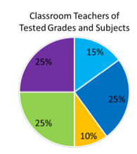
A Hawaii Growth Model Rating
Summative EES Ratings for
A rating of 4 is worth 25% of your overall teacher evaluation
Notes:
If this were your score, a rating of 4 would be worth 25% of your overall teacher of tested grades and subjects evaluation rating.

Slide 14
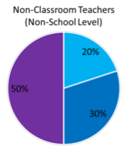
New Teacher/Missing Data
Summative EES Rating
Notes:
Your pie will be dependent upon what data you have. TRIPOD scores may be included if you have TRIPOD data.

Slide 15
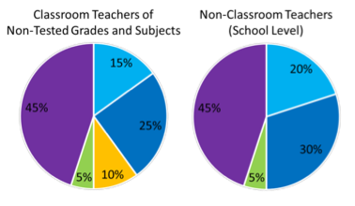
Hawaii Growth Model for Teachers of Non-Tested Grades and Subjects and NCTs
Summative EES Rating
http://eesteacher.weebly.com/ees-manual.html
Notes:
The process to determine a Hawaii growth model rating for classroom teachers of non-tested grades and subjects and non-classroom teachers is similar to the process that was previously presented.

Slide 16
Teachers of Non-Tested Grades and Subjects and Non-Classroom Teachers
School MSGP | Percentile rank | EES Rating
64 | 79 | 3
Notes:
The only two differences for non-tested, non-classroom teachers are:
First, you receive a SCHOOL median student growth percentile and NOT an INDIVIDUAL MSGP.
Second, your EES rating is reflective of your School’s Percentile Rank, not the rank you get as an Individual Teacher.
Let’s follow Kai to understand these differences:

Slide 17
ELA
303
335
353
376
415
371
436
445
451
480
11
31
50
58
Student Growth Percentiles
(SGP)
86
19
24
52
64
99
197
270
284
298
303
315
415
436
445
451
9
18
27
36
45
55
64
73
82
91
Notes:
READING SGPs for all students who have consecutive Reading HSA scores in your school were collected after peer groups and SGPs were determined.

Slide 18
Reading School Median Student Growth Percentile
STUDENT NAME | SCHOOL | GRADE | STUDENT Growth Percentile (Reading)
Ethan | Your School | 5 | 91%
Kai | Your School | 4 | 82%
Jana | Your School | 6 | 78%
Kyle | Your School | 4 | 75%
Cole | Your School | 5 | 65%
Malie | Your School | 6 | 64%
Rylen | Your School | 5 | 58%
Jaren | Your School | 4 | 53%
Kami | Your School | 5 | 48%
Gerald | Your School | 6 | 34%
Ikaika | Your School | 6 | 32%
YOUR SCHOOL’S READING MSGP
is 64.
Notes:
These scores from your school were put in numerical order
and the middle SGP is your SCHOOL’s Median Growth Percentile.
In this example, your school has a READING School MSGP of 64%.

Slide 19
FOR SCHOOL WIDE MSGPS
STUDENT NAME | Quarters in Class | STUDENT Growth Percentile (Reading)
Ethan | 4 | 88%
Jaimie | 4 | 85%
Jana | 3 | 78%
Kyle | 1 | 32%
MSGP of
87
Notes:
School MSGP data only include students who have have to taken the Reading HSA for two consecutive years AND have Full School Year Status.
Please note, using 4 quarters to equate to a school year was simply used to illustrate this point.
Please note Students are included in a school’s MSGP score based on whether they have full school year (FSY) status (http://eesteacher.weebly.com/1/post/2013/05/which-student-growth-percentile-sgp-scores-are-included-in-a-school-complex-and-complex-area-median-student-growth-percentile-msgp.html)

Slide 20
Percentile Rank
Teachers of Non-Tested Grades and Subjects
School MSGP | Percentile rank | EES Rating
64 | 79 | 3
School | Median Growth Percentile | Percentile Rank
School A | 50%
School B | 52%
School C | 53%
YOUR SCHOOL | 64%
School D | 75%
55%
60%
60%
79%
84%
4/10/14
20
Notes:
Applied to your rating, your percentile rank is
calculated by ranking all SCHOOL MSGPs
For this example, a SCHOOL Median Growth Percentile of 64
means your school scored within the 79th percentile for all school MSGP data that was collected.
Again, these corresponding percentile rank examples are hypothetical because actual ranks need to be determined by actual data.

Slide 21
Percentile Rank and Rating
Teachers of Non-Tested Grades and Subjects
School MSGP | Percentile rank | EES Rating
64 | 79 | 3
EES Rating | Corresponding Percentile Range
4 | 81-99
3 | 16-80
2 | 6-15
1 | 1-5
Notes:
In conclusion, the EES Rating for a teacher of non-tested grades and subjects and non-classroom teachers depend on your school’s percentile rank.
If your school’s percentile rank was a 79, your rating would be a 3.

Slide 22
A Hawaii Growth Model of 3
http://eesteacher.weebly.com/ees-manual.html
Notes:
Which means a score of 3 will be worth 5% of your overall rating.

Slide 23
How does the Hawaii Growth Model work?
SGPs
MSGPs
Percentile Ranks
Hawaii Growth Model Rating
Notes:
In summary, the Hawaii Growth Model is a process.
MSGPs provide data that provides percentile ranks.
And percentile ranks determine the EES ratings for the Hawaii Growth Model component of a teacher’s evaluation.
SGPs are the HEART of the Hawaii Growth Model process.
The individual components are reflective of this data.

Slide 24
Hawaii Growth Model Take Aways
An MSGP is the middle SGP score.
A Percentile Rank is the rank that is determined through MSGP data.
The Hawaii Growth Model EES rating corresponds to the provided Percentile Rank.
This rating is a weighted measure of an overall teacher evaluation.
Notes:
Regardless of your position, school level teachers must understand how the Hawaii Growth Model components relate to each other and affect their EES Rating.

Slide 25
www.pde3.k12.hi.us

Slide 26
SCROLL TO BOTTOM OF PAGE

Slide 27
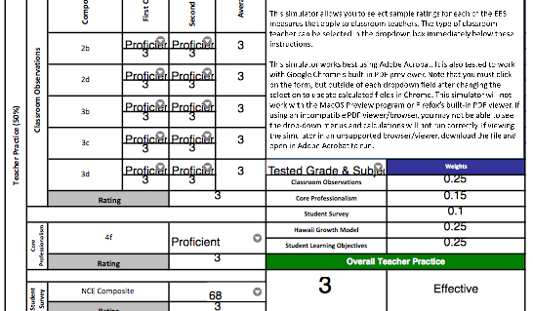
EES Rating Simulator
http://eesteacher.weebly.com/uploads/1/4/0/3/14039000/eesnonclassroomsimulation_2013-08-02.pdf
Notes:
You can check how ratings would affect your overall score by using the Rating Simulator on the eesteacher.weebly.com website.

Slide 28
All Information Provided
www.eesteacher.weebly.com
Items from this presentation can be found on
http://castlekahukucast.weebly.com/
Under the CAST Professional Development Tab
Notes:
For More Information on Student Growth Percentile, Data Distribution and SGP FAQs and behind the scenes functions of components discussed in this presentaion, please visit the Castle-Kahuku EES Website:

Slide 29
For more information on SGP
Please read The Hawaii Growth Model: A Technical Overview of the Student Growth
http://eesteacher.weebly.com/uploads/1/4/0/3/14039000/sgp_hawaii_growth_model_technical_overview_2012-02-28.pdf
Or visit Dave Moyer’s Prezi on Measuring and Calculating Student Growth
http://prezi.com/j5uuwx4oh7qe/?utm_campaign=share&utm_medium=copy
Please see the following prezi presentation narrated by Deputy Superintendent Ron Nozoe:
http://prezi.com/oabd6mbpv-o3/first-semester-2014-educator-effectiveness-data/
For more answers on more Frequently Asked Questions
http://eesteacher.weebly.com/uploads/1/4/0/3/14039000/sgp_faq_2013-06-04.pdf

Slide 30
Thank You!
Notes:
For More Information on Student Growth Percentile, Data Distribution and SGP FAQs and behind the scenes functions of components discussed in this presentaion, please visit the Castle-Kahuku EES Website:

